Slide 1
Reversing
An Ode to Bayes’ Theorem
by Steven Malan
Notes:
Email address in notes on last slide.

Slide 2


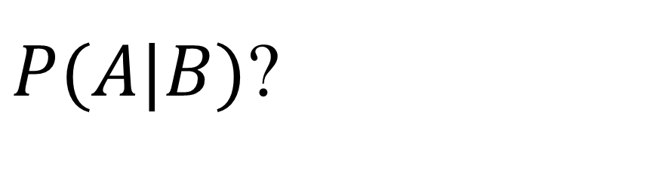
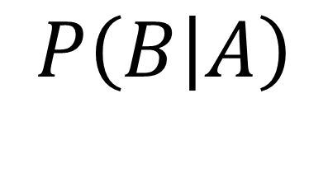
Reversing
I have “B given A,” but want “A given B.”
How to untangle them, I really can't see.
A simple reversal isn't allowed.
Ugh! Stats is hard! My math used to feel proud.
$$P\left(B | A\right)$$
$P(A|B)$?

Slide 3
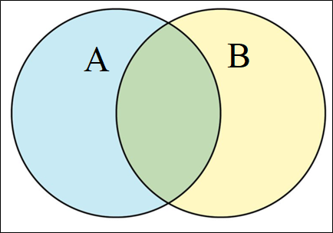
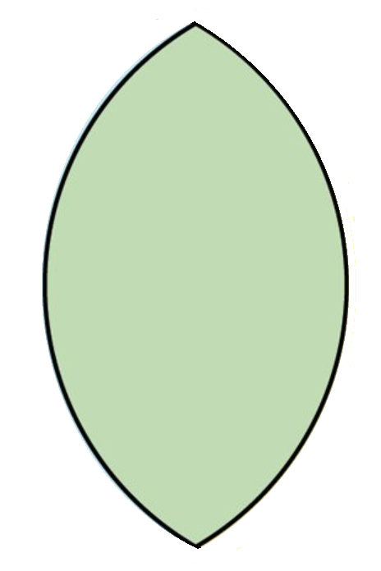
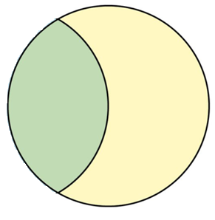
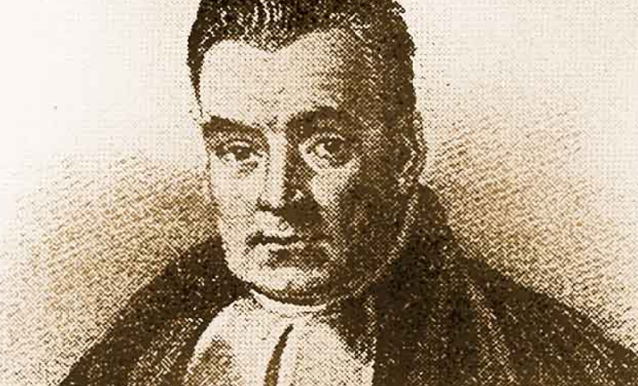

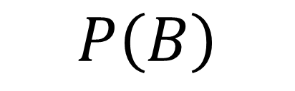
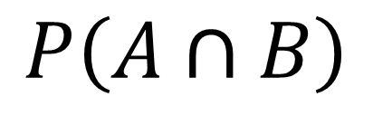
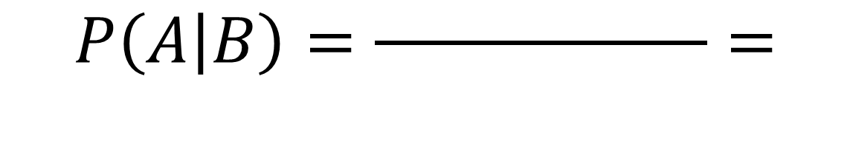
Reversing
But then Thomas Bayes comes to my aid.
He says, “First think of A and B overlaid.
Then ask the chances that B would occur
And find a proportion in this order.”
$$P\left(A∩B\right)$$
$$P\left(A | B\right)=\frac{ }{ }=$$
$$P\left(B\right)$$

Slide 4

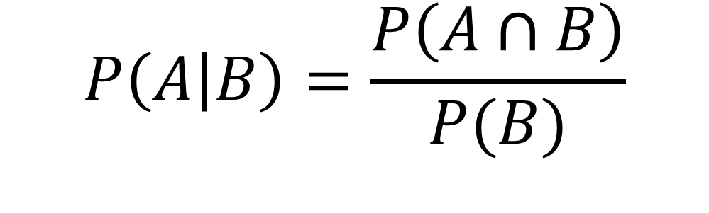
Reversing
I have “P A and B” over “P B”
Bayes says, “Good start, but the bottom's not free.”
Sometimes we don't know B on its own,
Nay, only if the fate of A is first known.
$$P\left(A | B\right)=\frac{P\left(A∩B\right)}{P(B)}$$

Slide 5
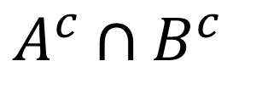

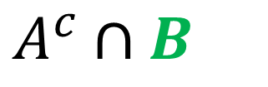

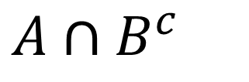
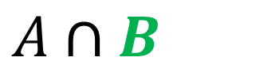


Reversing
So out sprouts a tree, with A first, then B,
(The order in which they were given to me).
I follow each branch to where B is the end.
The sum of these branches is my new best friend.
$A∩B$
$A$
$A∩B^{c}$
$A^{c}∩B$
$A^{c}$
$A^{c}∩B^{c}$

Slide 6

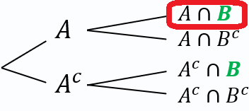
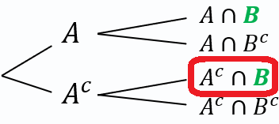
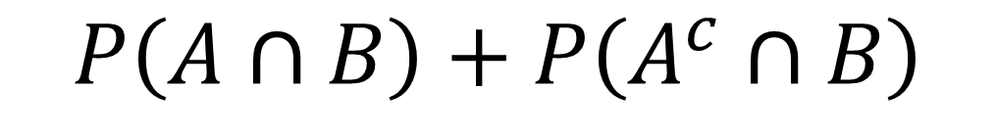
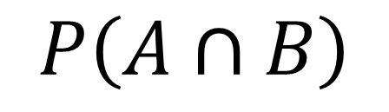
Reversing
Now we have "P A and B" up on top,
And sitting below, we find B, all chopped up.
We did it! We reversed "B given A"
Let's practice some more and get ready for May!
$$P\left(A∩B\right)$$
$$P\left(A | B\right)=\frac{ }{ }$$
$$P\left(A∩B\right)+P\left(A^{c}∩B\right)$$

Slide 7
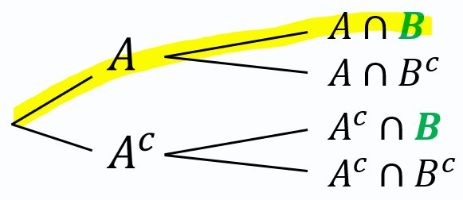
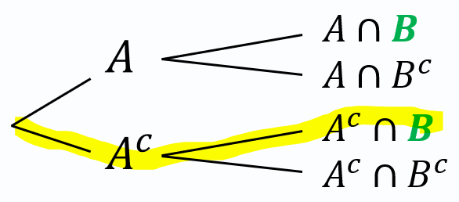

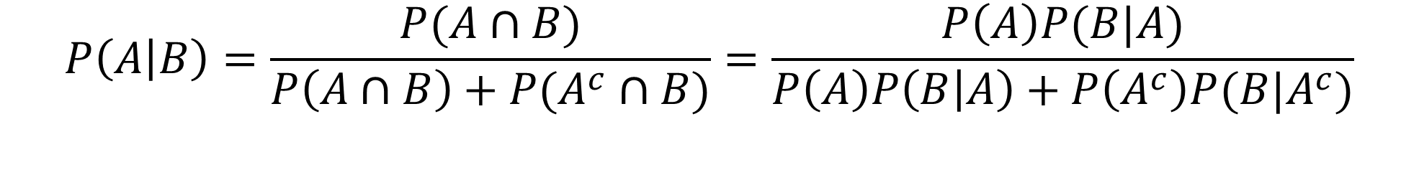
(Notation)
In a tree diagram, these “$∩$” and probabilities are ultimately found by multiplying along the branches. This yields the typical (and much uglier) statement of Bayes’s Theorem.
$$P\left(A | B\right)=\frac{P(A∩B)}{P\left(A∩B\right)+P(A^{c}∩B)}=\frac{P\left(A\right)P(B|A)}{P\left(A\right)P\left(B | A\right)+P\left(A^{c}\right)P(B|A^{c})}$$

Slide 8
Practice Time!
Chapter 15, #43 (Stats: Modeling the World 3e, p. 365)
Dan’s Diner employs three dishwashers. Al washes 40% of the dishes and breaks only 1% of those he handles. Betty and Chuck each wash 30% of the dishes, and Betty breaks only 1% of hers, but Chuck breaks 3% of the dishes he washes. (He, of course, will need a new job soon. . . .) You go to Dan’s for supper one night and hear a dish break at the sink. What’s the probability that Chuck is on the job?
Draw: Draw a tree diagram with 15 probabilities all labeled perfectly.
Talk: Explain how this is a “reverse conditioning” problem.
Do: Answer the question, using appropriate notation.
Notes:
Math answer below:
$\frac{.009}{0.004+0.003+0.009}=\frac{9}{16}=0.5625$
Corrections? Comments? steven.malan@isqchina.com
stevenmalan at gmail.com

